Slide 1

Visual Basic Project
Sahadat Ali
BCA 1ST YEAR

Slide 2

About Visual Basic 6.0
Visual Basic is a third-generation event-driven programming language and integrated development environment from Microsoft for its Component Object Model programming
model first released in 1991 and declared legacy during
2008. Microsoft intended Visual Basic to be relatively
easy to learn and use.

Slide 3

FEATURES OF VISUAL BASIC 6.0
VB introduces the concept of Event Driven programming Model.
It has built in Database Handling Features of VB.
It incorporated the concepts of objects.
It has useful Error – Handling Features.
It has Front – End Application Developer.
It also known as RAD ( Rapid Application Development )

Slide 4

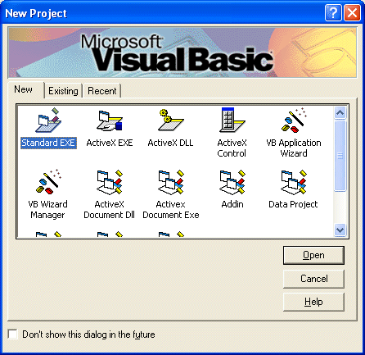
How to start visual basic?
TO START VISUAL BASIC,THE STEPS ARE -
Click on Microsoft Visual Studio 6.0
The new project window appears, the new project window
has three tabs :
New : To start a new project.
Existing : To select from a list of existing projects.
Recent : To select from the list of recently opened.
3. In new project window select standard.EXE application.
This opens Microsoft visual basic window.

Slide 5
COMPONENTS OF VB WINDOW

Slide 6
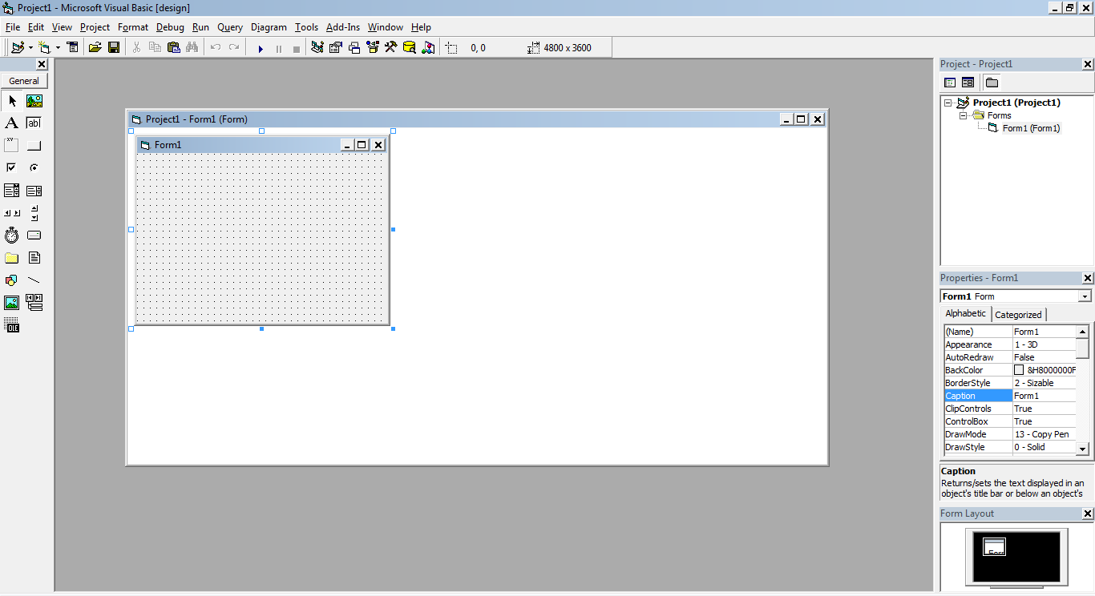
Title Bar
Menu Bar
Project Window
Form Window
Tool Bar
Properties Window
Properties Layout Window

Slide 7

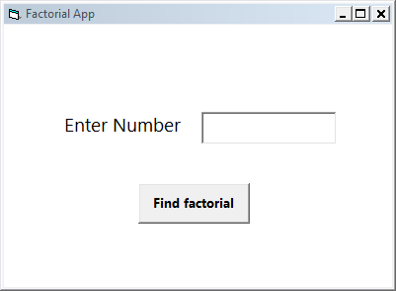
Example Program
DESIGN WINDOW

Slide 8

Dim n As Integer
Dim fact As Integer
fact = 1
n = 1
n = Val(Text1.Text)
For i = 1 To n
fact = fact * I
Next
MsgBox "factorial of " & n & " is = " & fact
CODE FOR THE PROGRAM

Slide 9

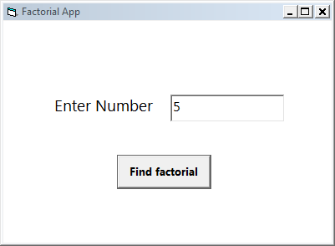
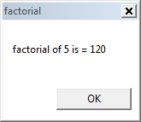
OUTPUT OF THE PROGRAM

Slide 10

THE END

